Slide 1
PayPocket - Data Visualization
Ruchi Amin, Suyash Shrivastava, Prithak Bhattacharyya, Brooke McDermott, & Ayushi Chauhan
• 04.29.2022

Slide 2





Team Overview
Ruchi Amin
Prithak Kr. Bhattacharyya
Ayushi Chauhan
Brooke McDermott
Suyash Shrivastava
Introduction
Data Understanding
Data Preparation
Dashboarding
Predictive Modeling
Software Selection
Deployment
Notes:
personal introductions

Slide 3
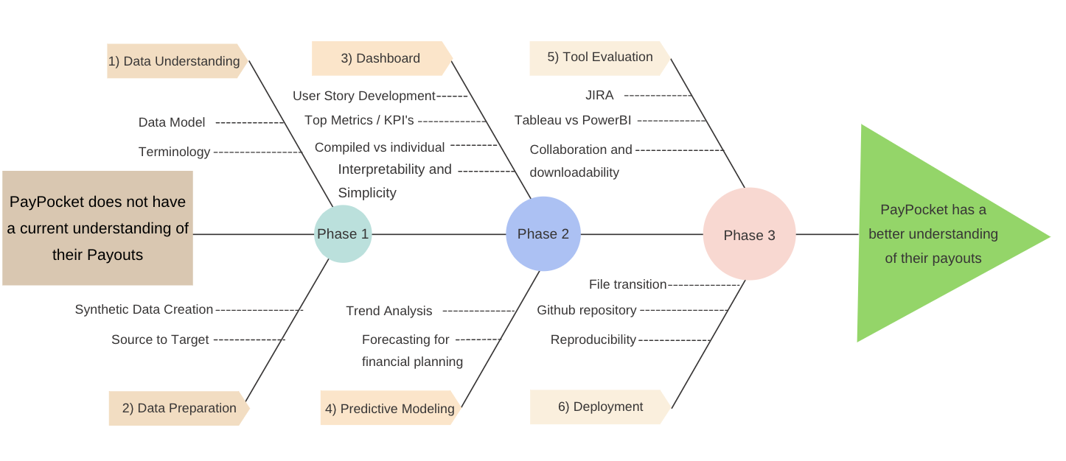
Executive Summary
Introduction
Data Understanding
Data Preparation
Dashboarding
Predictive Modeling
Software Selection
Deployment
Notes:
brooke
step 2: user story development - talk about how we followed crisp-dm process when developing specific visualizations, agile for trackign status and user stories
CRISP-DM but embedding agile user stories to develop it
using both frameworks with intent

Slide 4
Purpose of Capstone
Name verification service: validate, capture, and analyze data at the point of retrieval
Create an interactive and constantly updated data visualization dashboard based on the payee - the customer, and payer - the retailer
Introduction
Data Understanding
Data Preparation
Dashboarding
Predictive Modeling
Software Selection
Deployment
Notes:
ruchi

Slide 5
Business Problem
PayPocket delivers customer rebates using price matching to allow customers the opportunity to find a lower price within 30 days of purchase.
Understand the flow and characteristics of the payouts
Use standard, existing libraries to understand the velocity and volume of payments, where geographically payments are being made, and what types of accounts are receiving payout
Introduction
Data Understanding
Data Preparation
Dashboarding
Predictive Modeling
Software Selection
Deployment
Notes:
ruchi

Slide 6
Impact on different segments
Effects on different executives and directors within the company
User stories: marketing executive, sales director, chief financial officer, developer, and chief operating officer’s need and access to PayPocket
Each team member created a user story & dashboard
Utilized various visualitions, data points, and combination of variables for their user’s needs.
Final dashboard is a collection of these user stories to be the most adaptive and useful curation of visualization for PayPocket and its future endeavors.
Introduction
Data Understanding
Data Preparation
Dashboarding
Predictive Modeling
Software Selection
Deployment
Notes:
ruchi

Slide 7
Data Model Overview
Client Registry Master
Information regarding the Payers
Payments being sent out
User Profile Master
Information regarding the Payees
Payments being received
Payment Service Master
Information regarding the payment
Type, Status

Slide 8
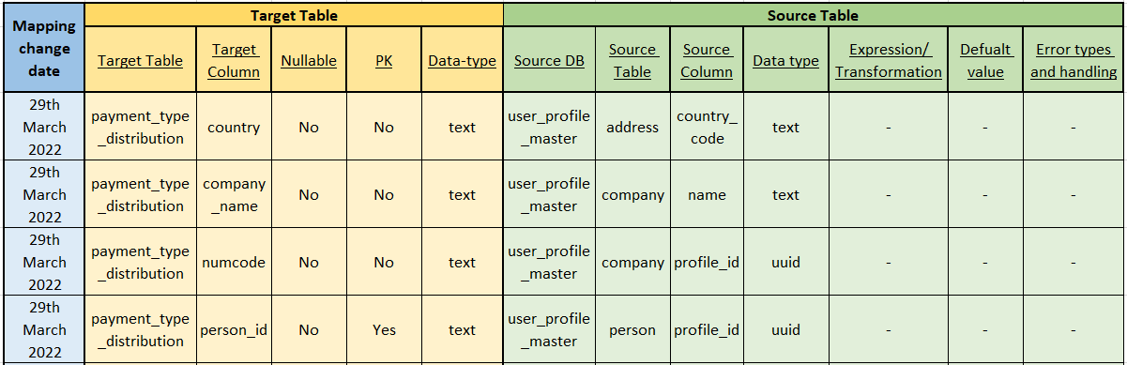
Data Model Overview
Source to Target Mapping
Client Registry Master (Information regarding the Payers )
User Profile Master (Information regarding the Payees)
Payment Service Master (Information regarding the payment )
Introduction
Data Understanding
Data Preparation
Dashboarding
Predictive Modeling
Software Selection
Deployment
Notes:
suyash (update to the excel sheet where it is the source to target mapping) - done!

Slide 9
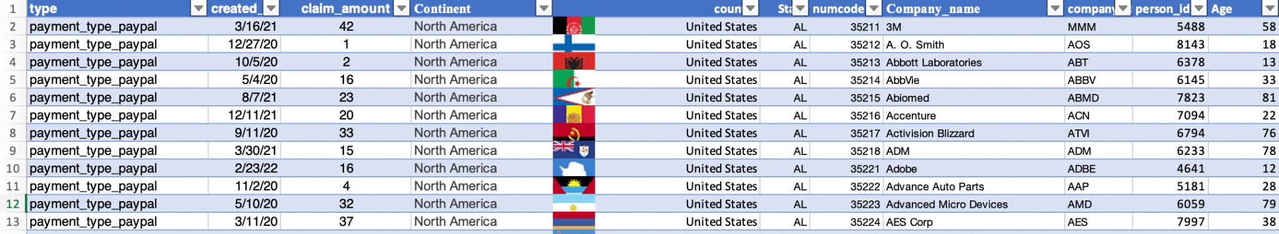
Synthetic Data Creation
Discussed the datatables and databases with our client to identify useful columns from Paypocket tables. Also, we learned about the type of data that each of the identified columns should contain.
Created user stories to identify which columns are relevant and repetitive in the four data tables. Example: company_id, person_id etc.
Prepared an excel file using functions like randbetween(), index(), date etc. targeting the Forbes 500 companies with the useful columns to cover all the user stories
Some columns are computed like age which are derived from columns like Date of Birth.
Introduction
Data Understanding
Data Preparation
Dashboarding
Predictive Modeling
Software Selection
Deployment
Notes:
ayushi

Slide 10
Descriptive Modeling
Gain an understanding of current and previous information
Transactions, payers, payees
Easier interpretation of raw data
Simple visualizations with high impact
High level overview of key metrics
Number of claims, amount of claims, status distribution
Develop understanding of data for effective modeling
predictive modeling
Introduction
Data Understanding
Data Preparation
Dashboarding
Predictive Modeling
Software Selection
Deployment
Notes:
brooke

Slide 11
Payer User Story
As a CFO, I need to see the number of transactions per payer per month so I can invoice payers properly
As a CEO, I need to see the top 10 payers based on claim amount and number of transactions to further understand how they are so successful
As a COO, I need to see the breakdown of payments based on continent, country, and state to track our payers expansion
Notes:
Prithak

Slide 12
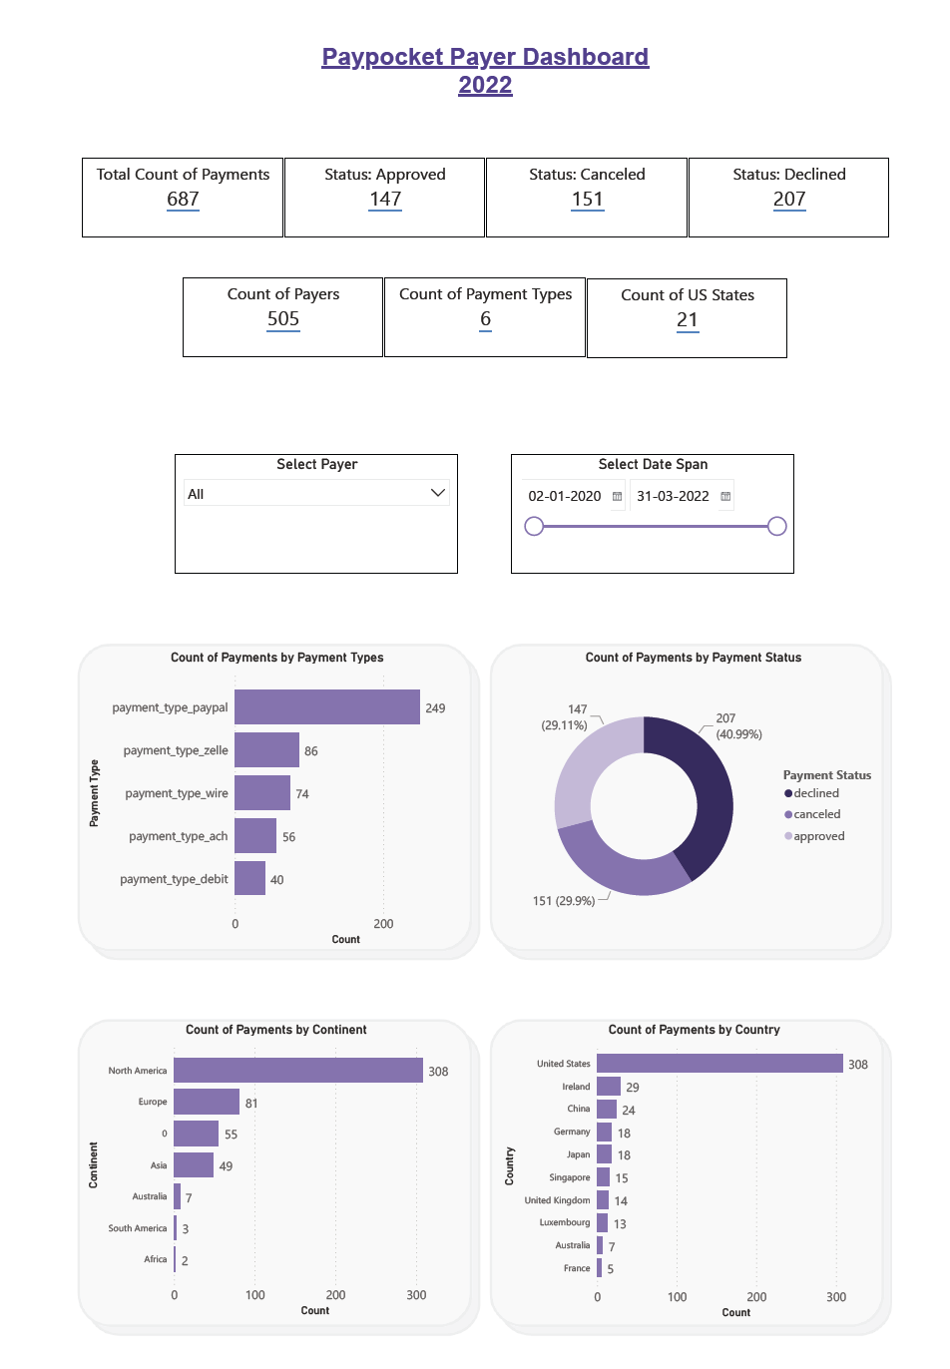
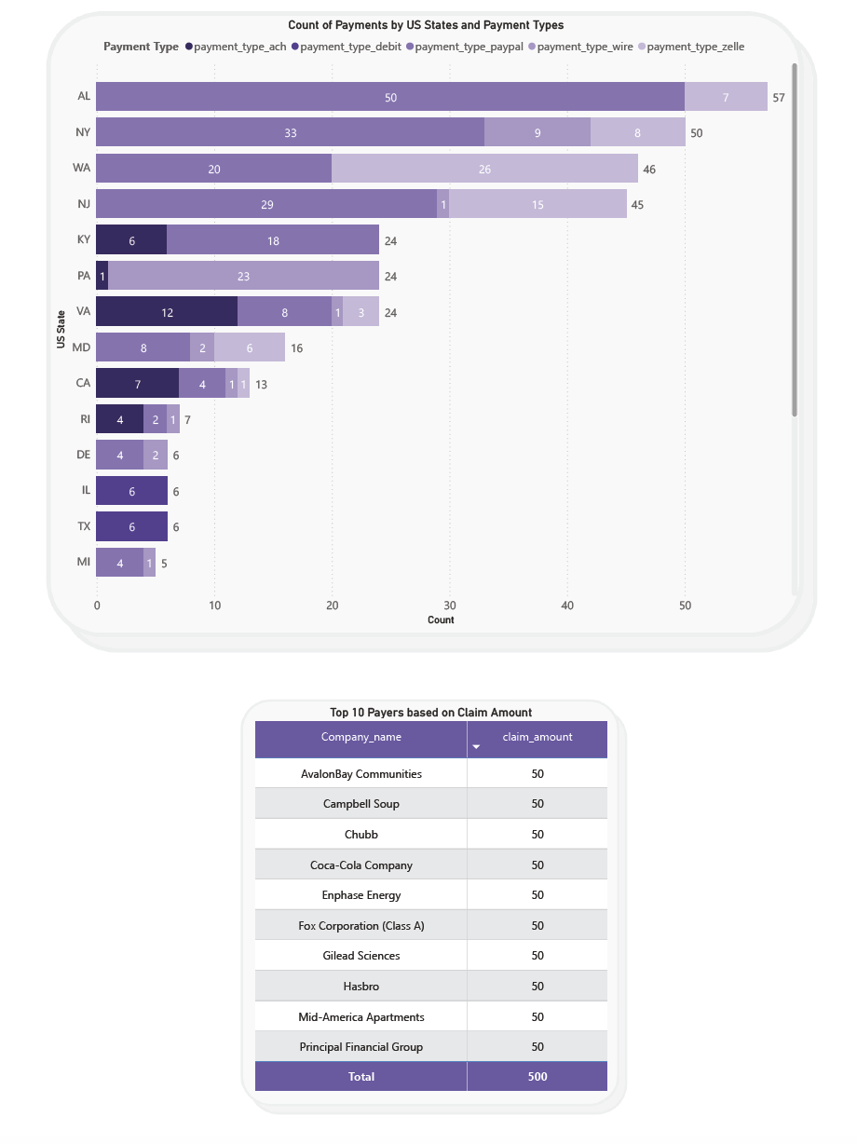
Payer Dashboard
Introduction
Data Understanding
Data Preparation
Dashboarding
Predictive Modeling
Software Selection
Deployment
Notes:
Prithak

Slide 13
Payee User Story
As a COO, I need to see the number of each transaction status per month to track the progress of the payout
As a Sales Executive, I need to see the distribution of payout methods to explain to our potential clients what channels we use most often
As a CMO, I need to see the location demographics of our payees to ensure we are marketing to our target market
Notes:
Prithak

Slide 14
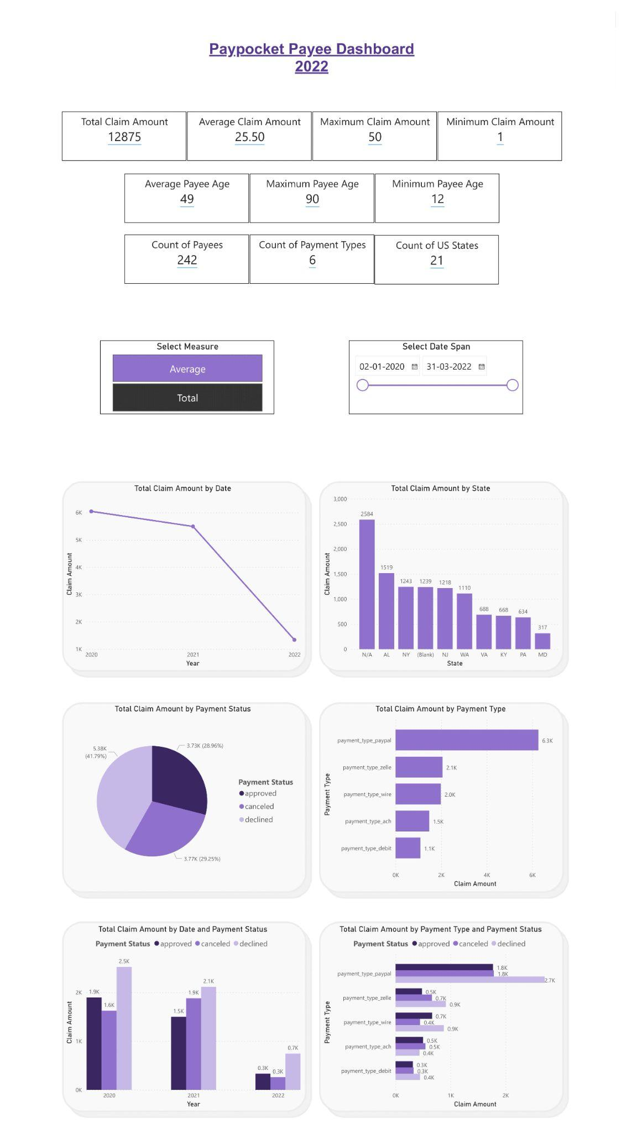
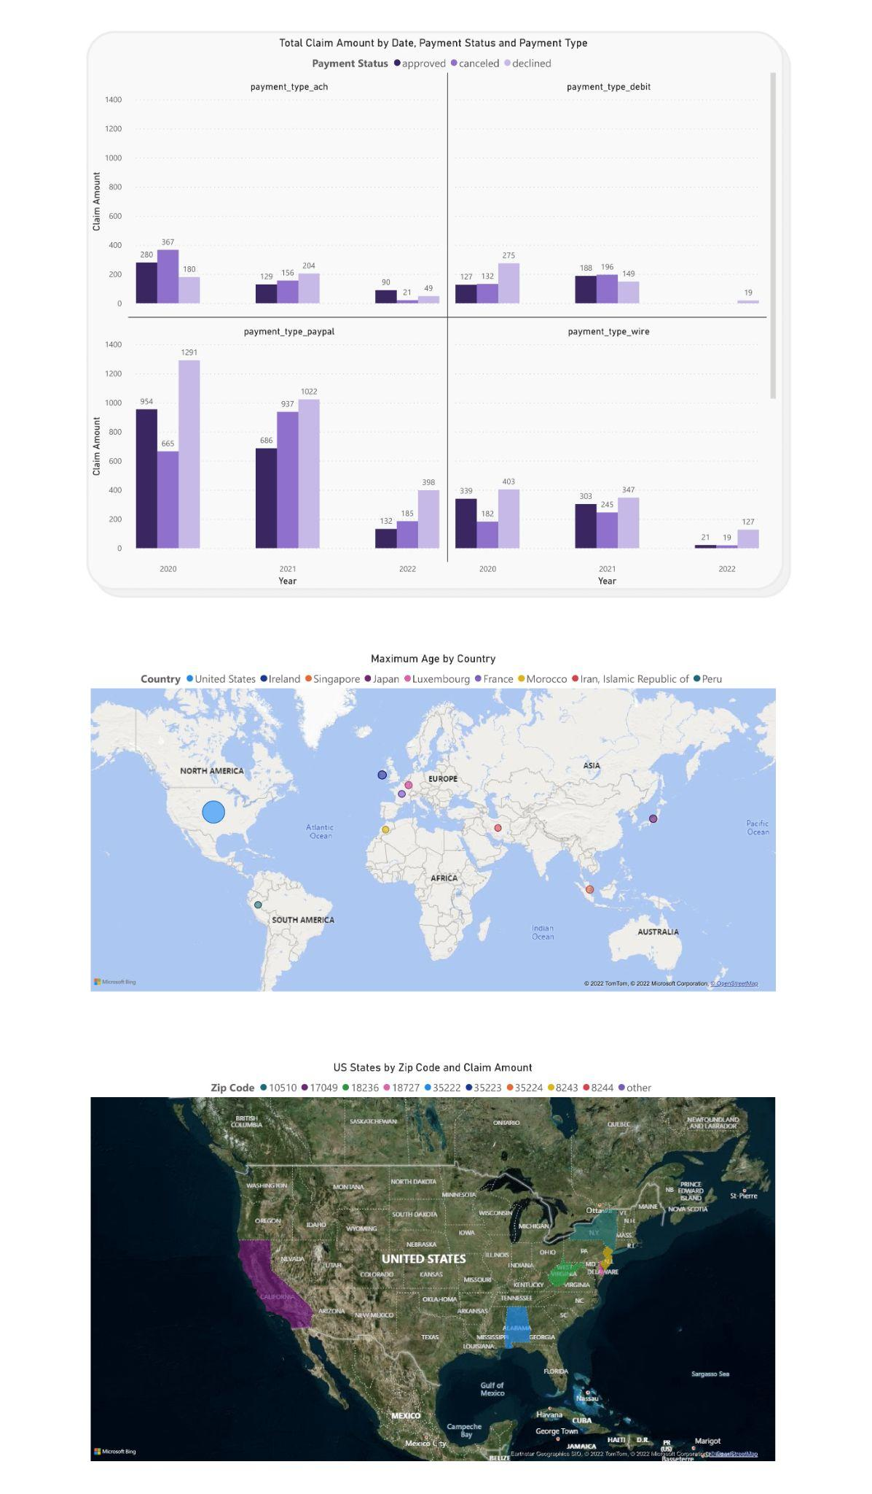
Payee Dashboard
Introduction
Data Understanding
Data Preparation
Dashboarding
Predictive Modeling
Software Selection
Deployment
pdf: https://drive.google.com/file/d/1TMuQRJD1eGPwLs6n81fFUpNZ2UrhCSIc/view?usp=sharing
Notes:
Prithak - add callouts to explain the user stories

Slide 15
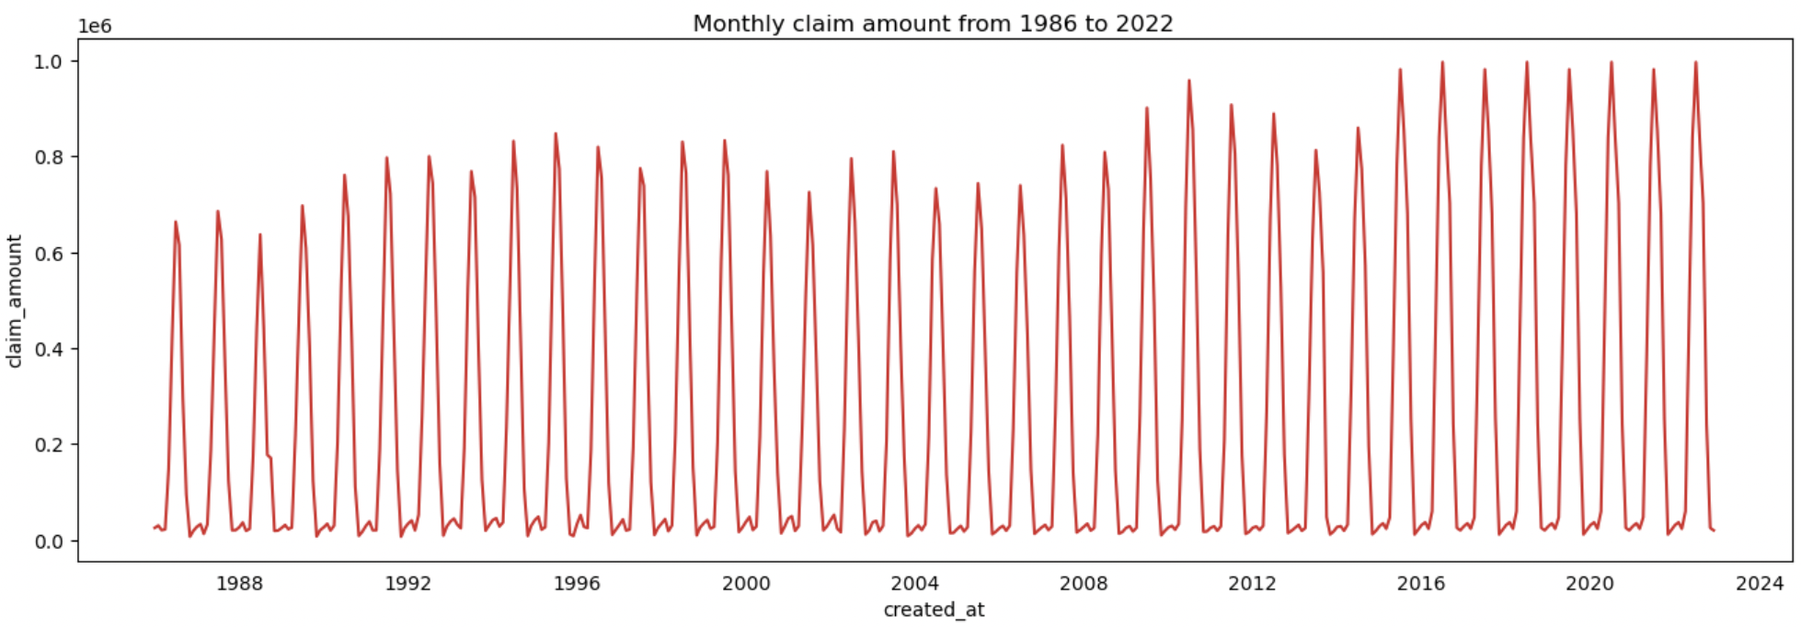
Predictive Modeling User Story
Based on the past years trend, we wanted to predict the Claim amount for the next three years.
Out of all the proposed models, identified the best model in doing so.
Performed prediction on the “continent” using other columns from the synthetic dataset
Introduction
Data Understanding
Data Preparation
Dashboarding
Predictive Modeling
Software Selection
Deployment
Notes:
Ayushi

Slide 16
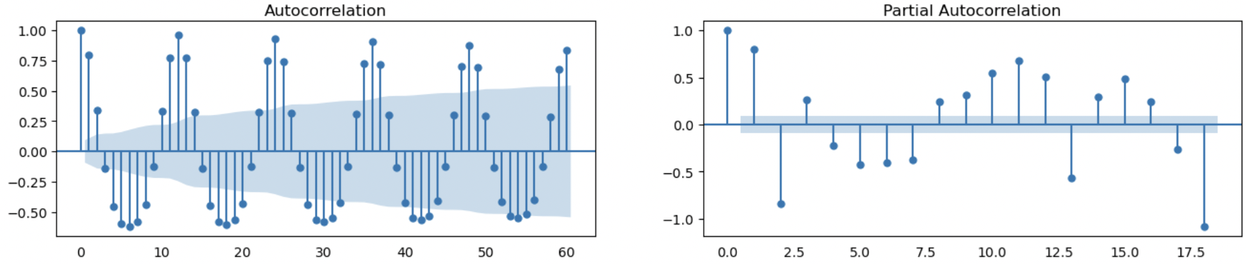
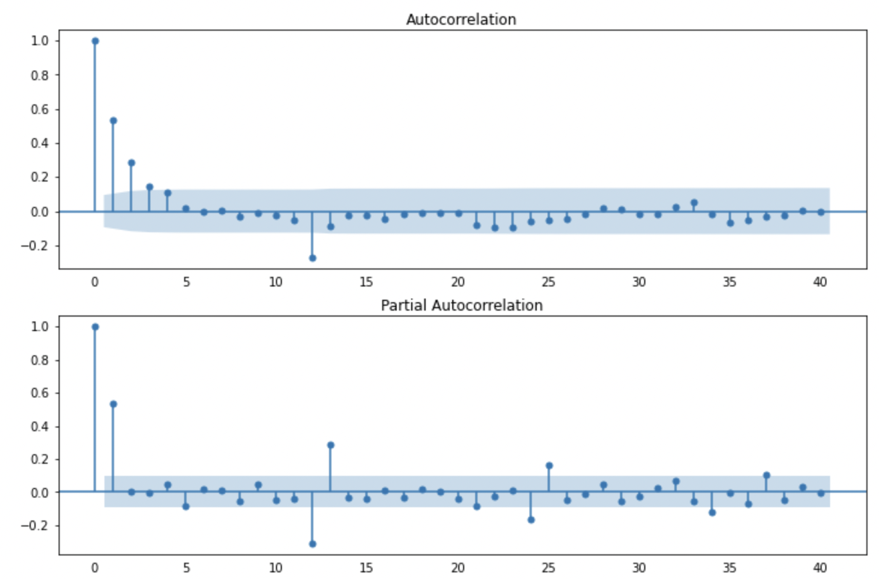
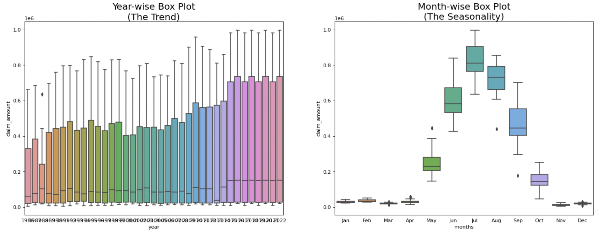
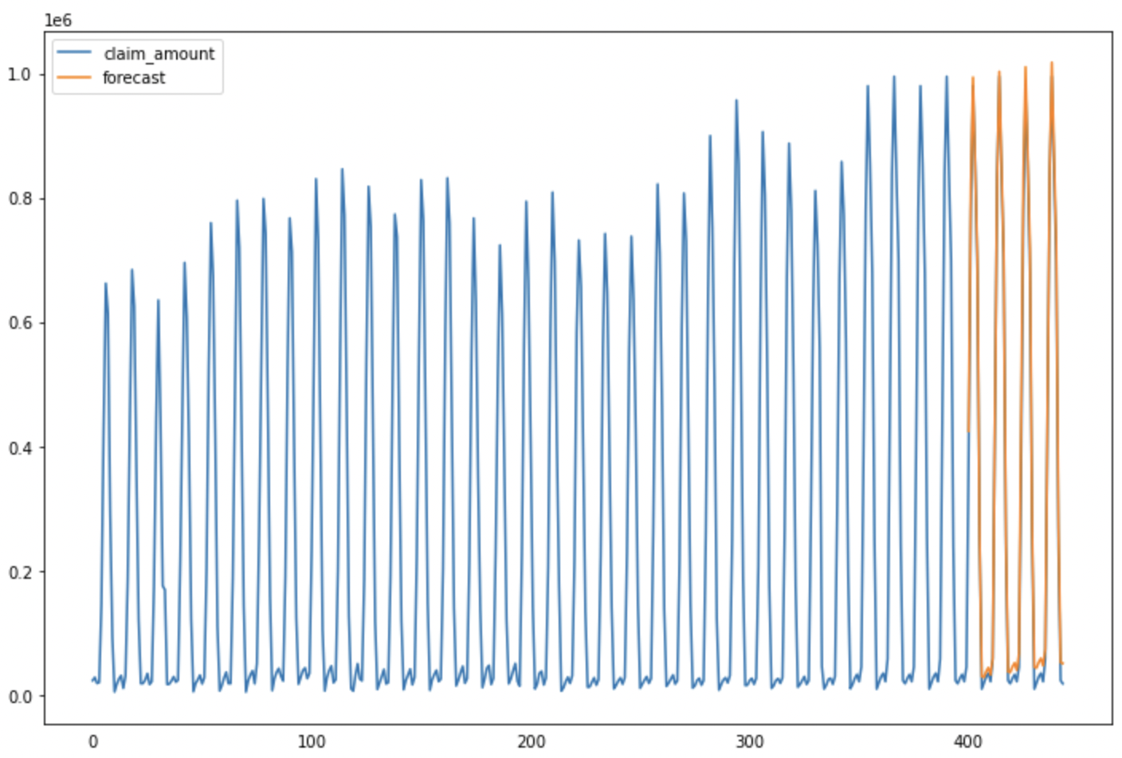
Predictive Modeling Output
ACF and PACF
Differenced series
Stationarity test results
Best model- SARIMAX
Introduction
Data Understanding
Data Preparation
Dashboarding
Predictive Modeling
Software Selection
Deployment
Notes:
Ayushi

Slide 17
Scorecard: Tableau vs PowerBI
Final Recommendation: Tableau
Criteria | Definition
Learning Curve and Ease of Use | time taken to adapt to the software by a user (technical/ non-technical)
Price Point | cost of usage
User Base, Community Support and Popularity | user community and popularity of the software
OS Support | works on Mac or Windows
Machine Learning Implementation and Support | how well ML can be implemented in the software to build the model
Reporting and Visualization tools | generating insightful visualizations and reports to deliver better recommendations
Data Storage | storing data and huge datasets
Performance with Live Data | ability to work with live data from various data sources
Introduction
Data Understanding
Data Preparation
Dashboarding
Predictive Modeling
Software Selection
Deployment
Notes:
Suyash

Slide 18
Project Management: JIRA
Transparency
Sprints, status roadmap, backlog
Collaboration
Effective utilization of comment section
Accountability
Assigning tasks, due dates
Integration
Google Drive and documentation
Introduction
Data Understanding
Data Preparation
Dashboarding
Predictive Modeling
Software Selection
Deployment
Notes:
Brooke

Slide 19
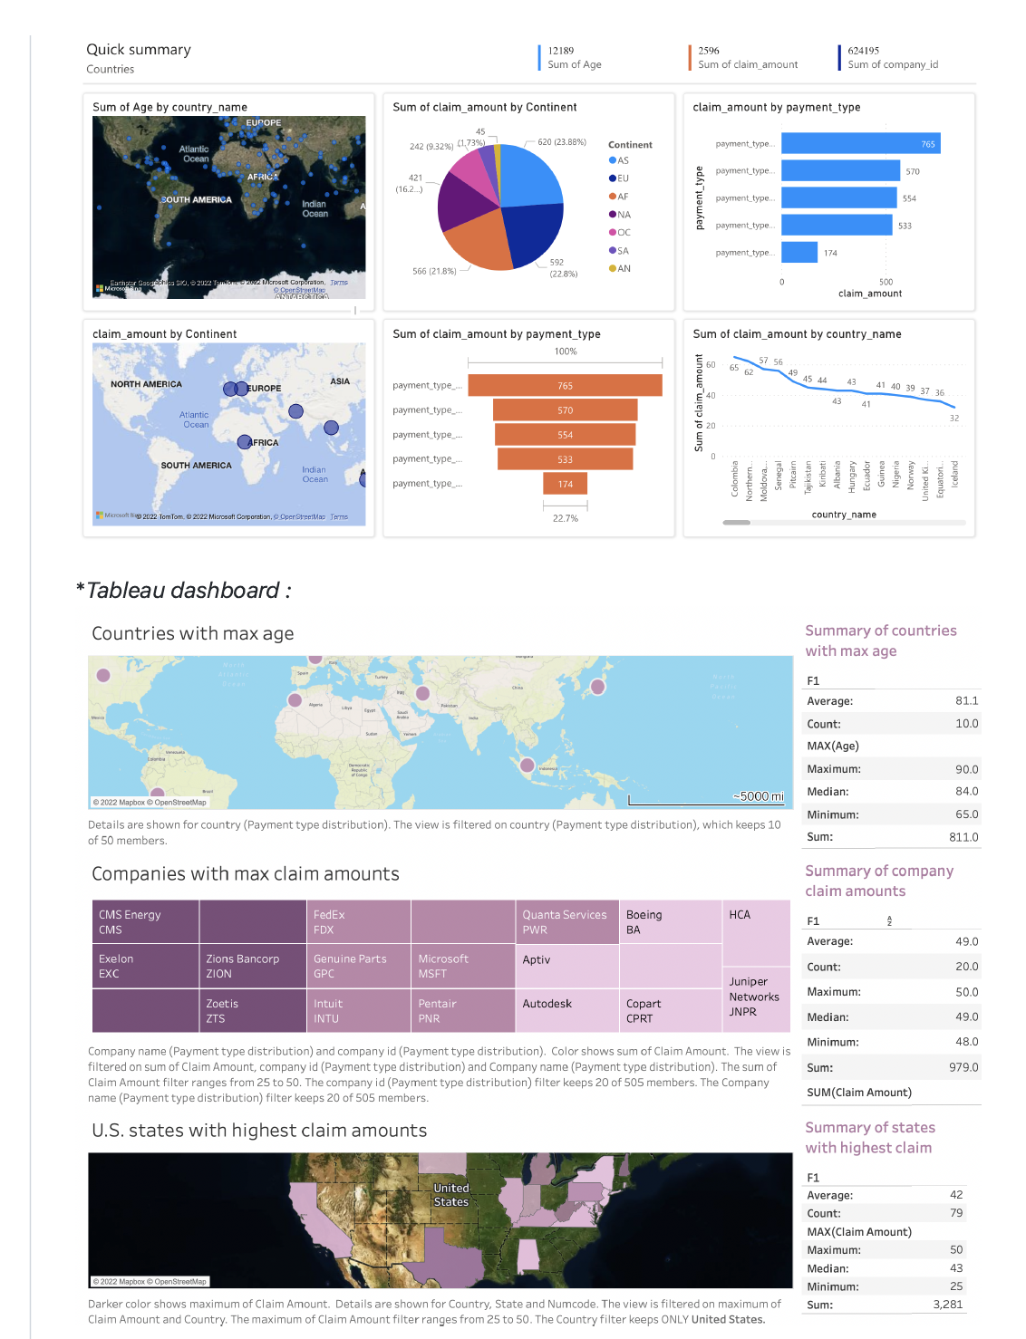
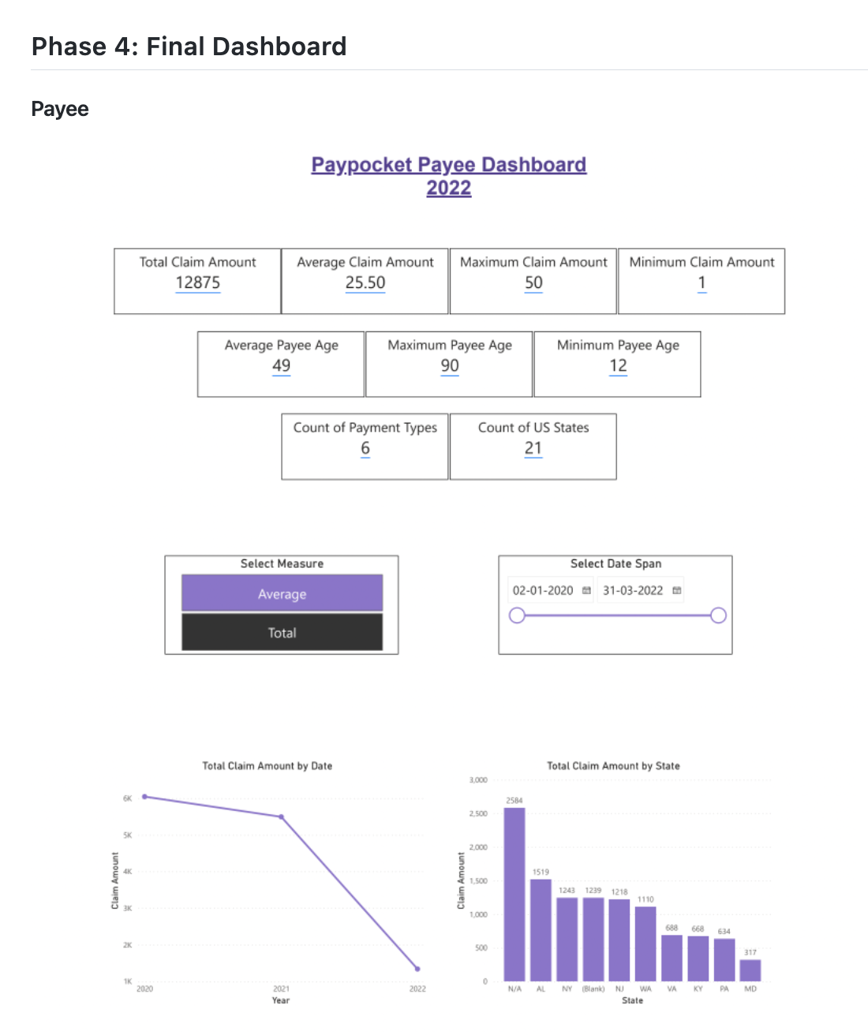
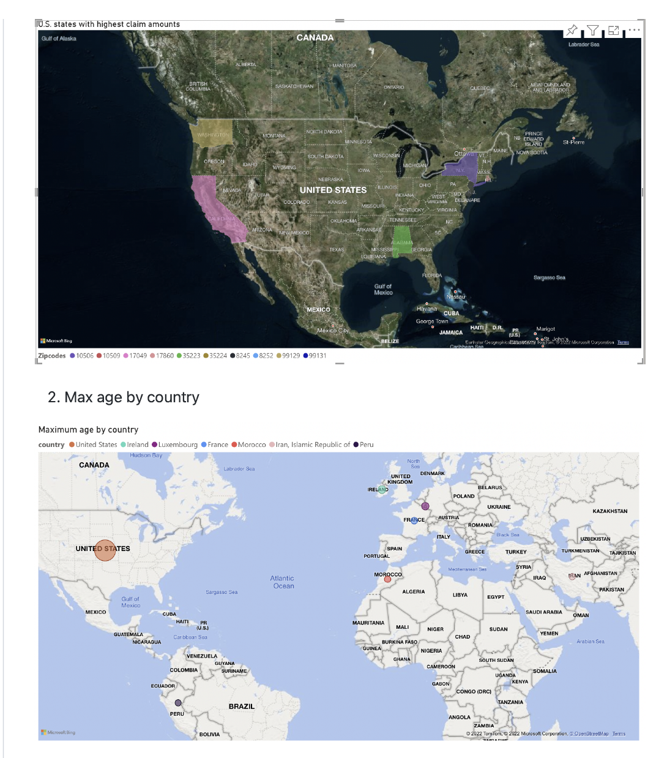
Personal Deployment: Github
Introduction
Data Understanding
Data Preparation
Dashboarding
Predictive Modeling
Software Selection
Deployment
Notes:
See other github links in appendix

Slide 20
Overcoming Challenges
01
Ensuring Access to all Documentation and Having a Designated “Screen Sharer”
Difficulty sharing screens in meetings
02
Creating Flat Files and CSV Files for data sharing
Postgres was difficult to integrate and utilize effectively
knowledge gap within the team
Data visualization is the priority
Not a data storage project
03
Allocating more time for Data Understanding in the Beginning
Constant data rework
Inconsistent data
Non-representative dashboards
04
Developing a team role for compiling dashboards / visualizations
Difficulty to collaborate with PowerBI
Lack of Mac OS compatibility with PowerBI
05
Simplifying dashboards by grouping them based on Payer and Payee
Disorganized dashboards that lacked a story
Busy and non-essential visuals
Introduction
Data Understanding
Data Preparation
Dashboarding
Predictive Modeling
Software Selection
Deployment
Notes:
designated prithak as a compiler to overcome the lack of compatibility within PowerBI

Slide 21
Challenges: Software
01
Difficulty sharing screens
All team members had access to every document
Designated back up “screen sharer”
Logistical Issues
02
Difficult to integrate
Knowledge gap within team
Developed flat files
Focus is business analytics
Stopped Postgres Usage
03
Cost effective
Easy to access
Pre-developed purpose in software
Open Source vs Licensure
Notes:
Brooke

Slide 22
Challenges: Data Creation
01
Designate extra time to data understanding in the beginning
Develop source to target as data is being created
Insufficient Time Allocation
02
Track changes and additions in real time
Develop source to target for reproducibility
Tracking Column Selection
03
Clean the synthetic data created
Ensure it is accurate and realistic
Develop more rows than planned
Lack of Sufficient Data
Notes:
Brooke

Slide 23
Challenges: Visualizations
01
MAC OS team members obtained a 60 day free trial of PowerBI Pro to gain access to PowerBi cloud
Lack of Compatibility with Desktop PowerBI
02
Create team structure by having a designated team member to manually compile files
Sent screenshots of dashboard and their settings for reproducibility
Inability to Collaborate within PowerBI
03
Group dashboards by payer vs payee
Simple and interpretability graphs
Top N or Bottom N for tables
Overwhelming Dashboards
Notes:
Brooke

Slide 24
Impact on PayPocket
Dashboards
Predictive Modeling
Ability to make effective business decisions
Transparent understanding of current operations
Track progress of initiatives
Sales ready company portfolio
Forecast the future of PayPocket based on current and past operations
Ability to adjust / adapt based on model output
Financially prepare for the future claims
Introduction
Data Understanding
Data Preparation
Dashboarding
Predictive Modeling
Software Selection
Deployment
Notes:
Brooke

Slide 25
Thank you!
Questions?

Slide 26
Appendix
Please refer to the following slides for supporting and other information

Slide 27
Dashboard Iterations

Slide 28
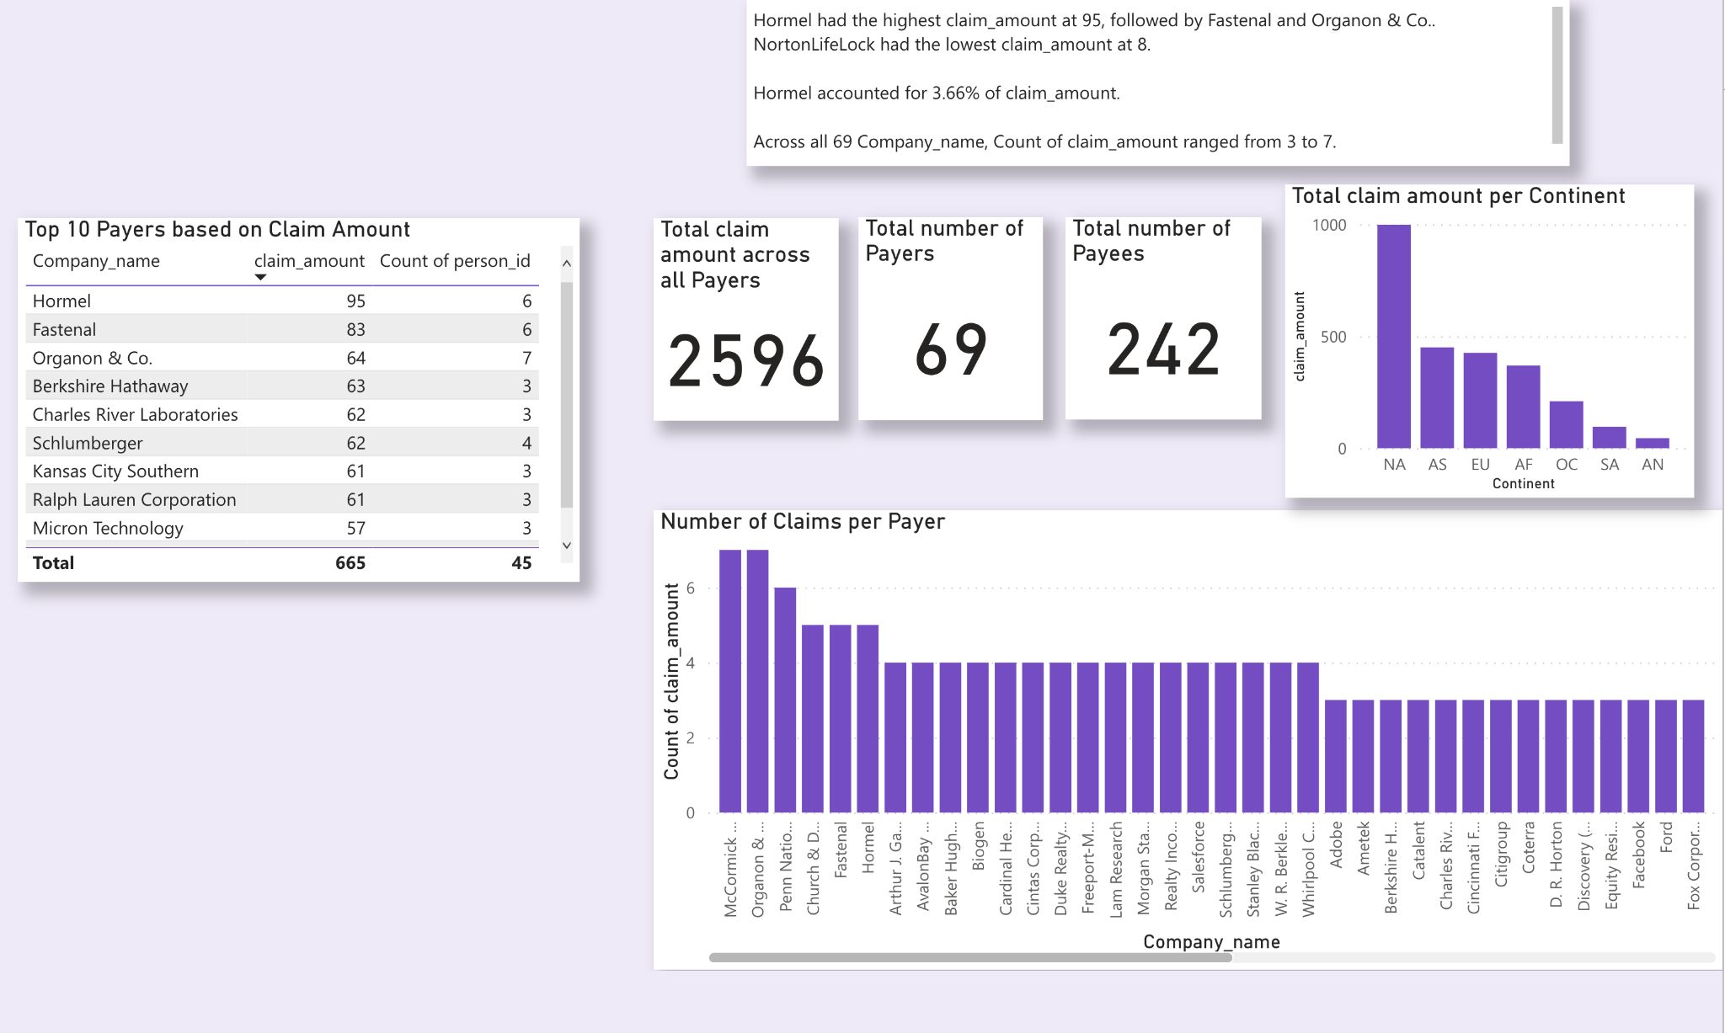
Dashboards: Payer Information using PowerBI

Slide 29
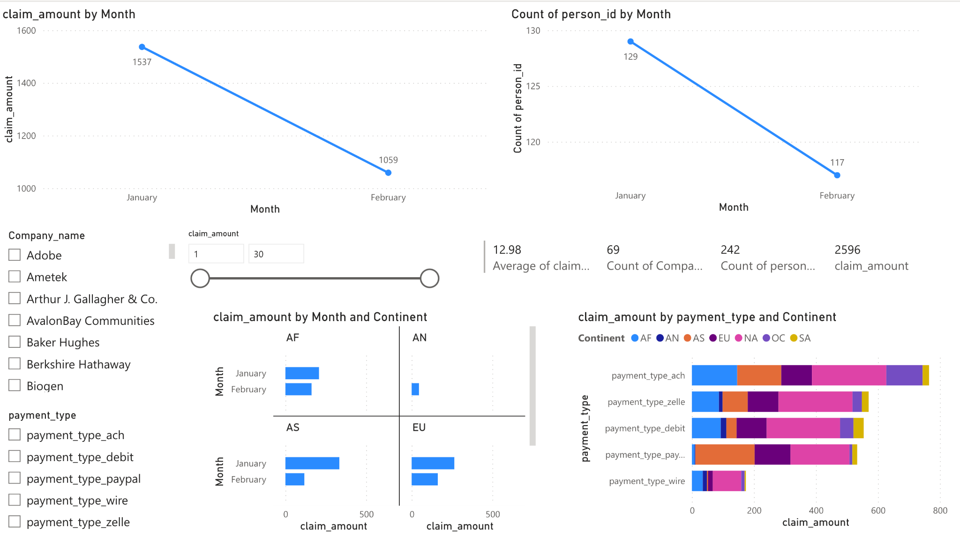
Dashboards: Payer Information using PowerBI

Slide 30
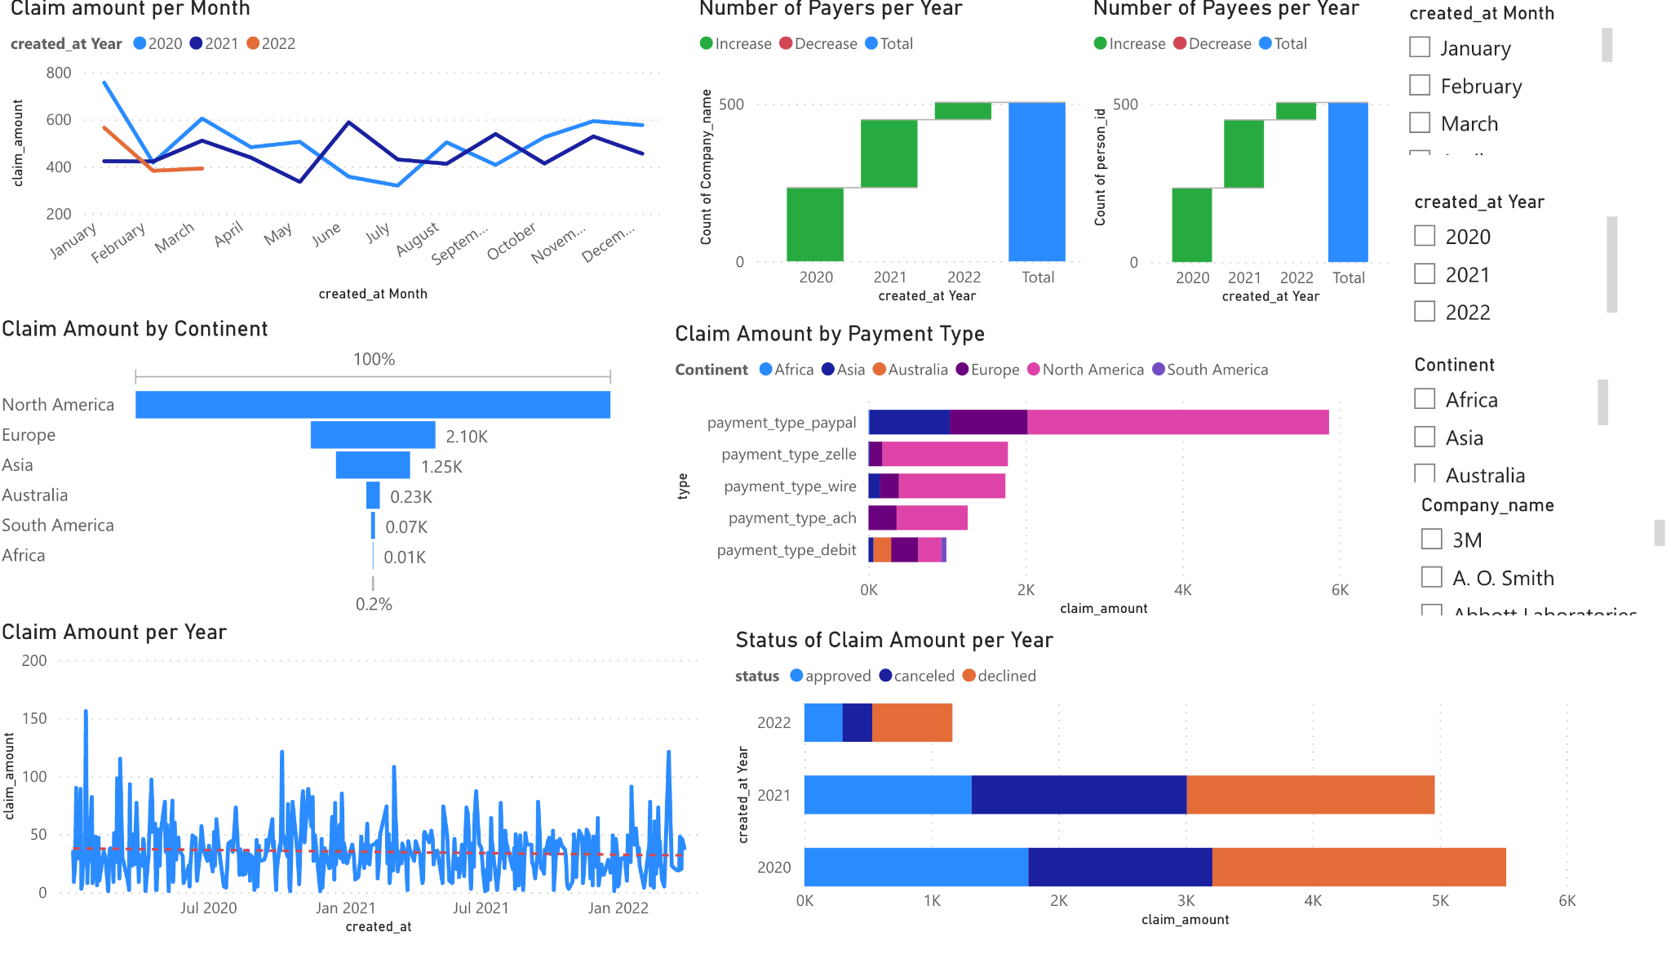
Dashboards: Payer Information using PowerBI

Slide 31
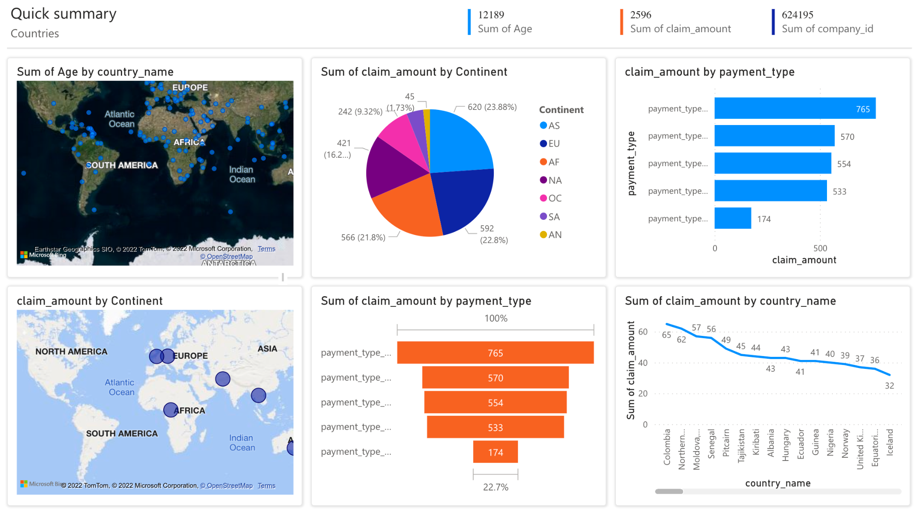
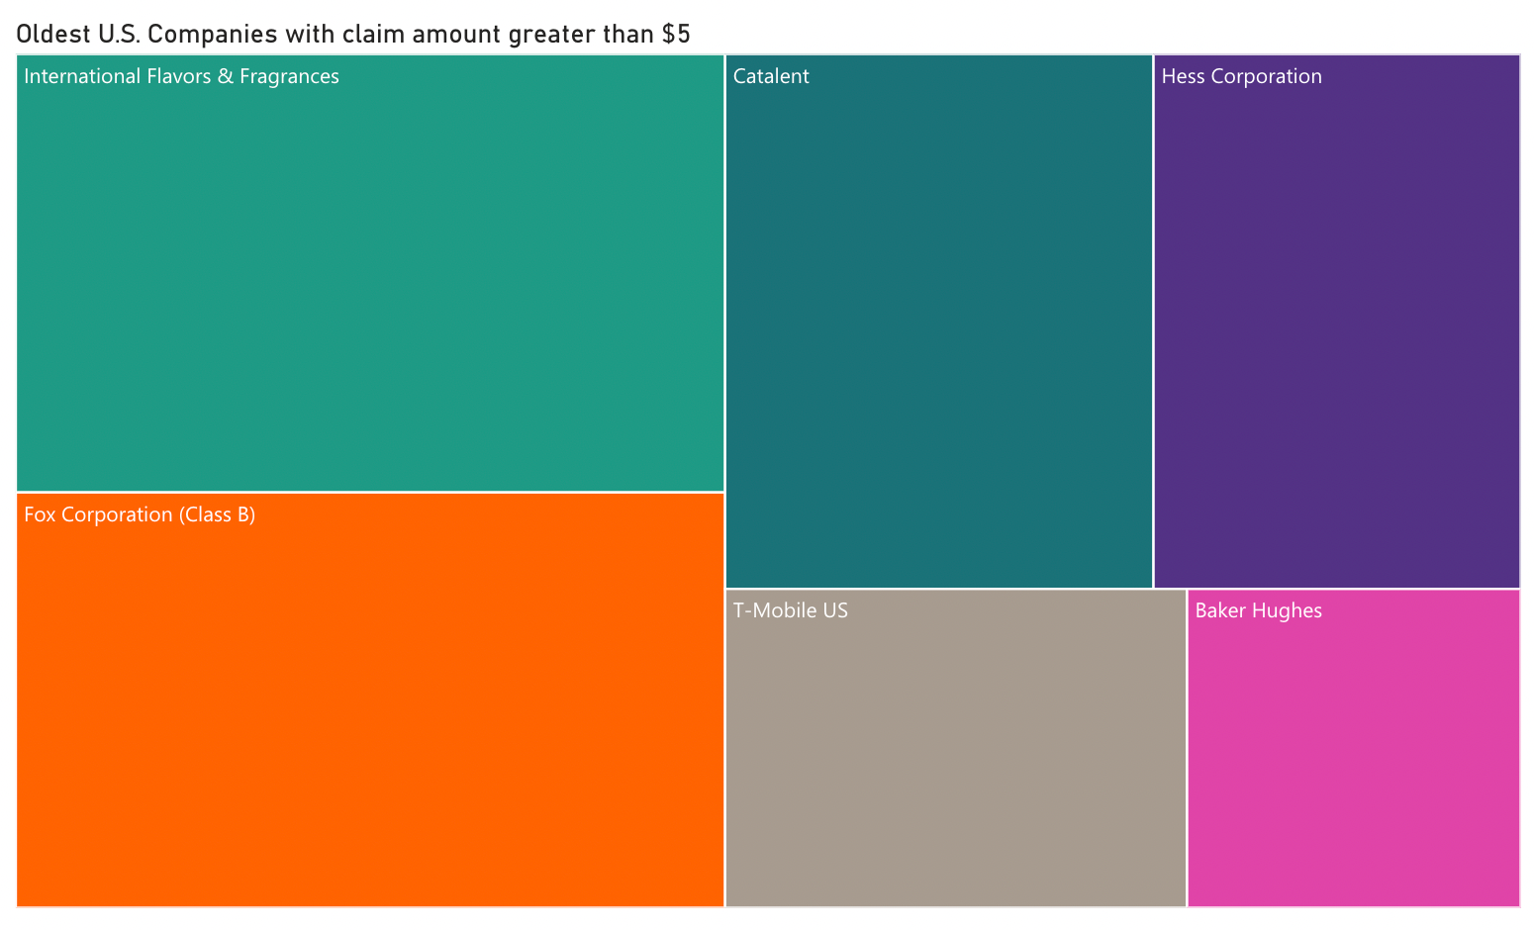
Dashboards: Countries and companies using PowerBI
As a marketing executive, I want to focus on countries and continents with highest claim amounts.
Also, want to focus on our company’s relations with well-established brands that have large claim amounts

Slide 32
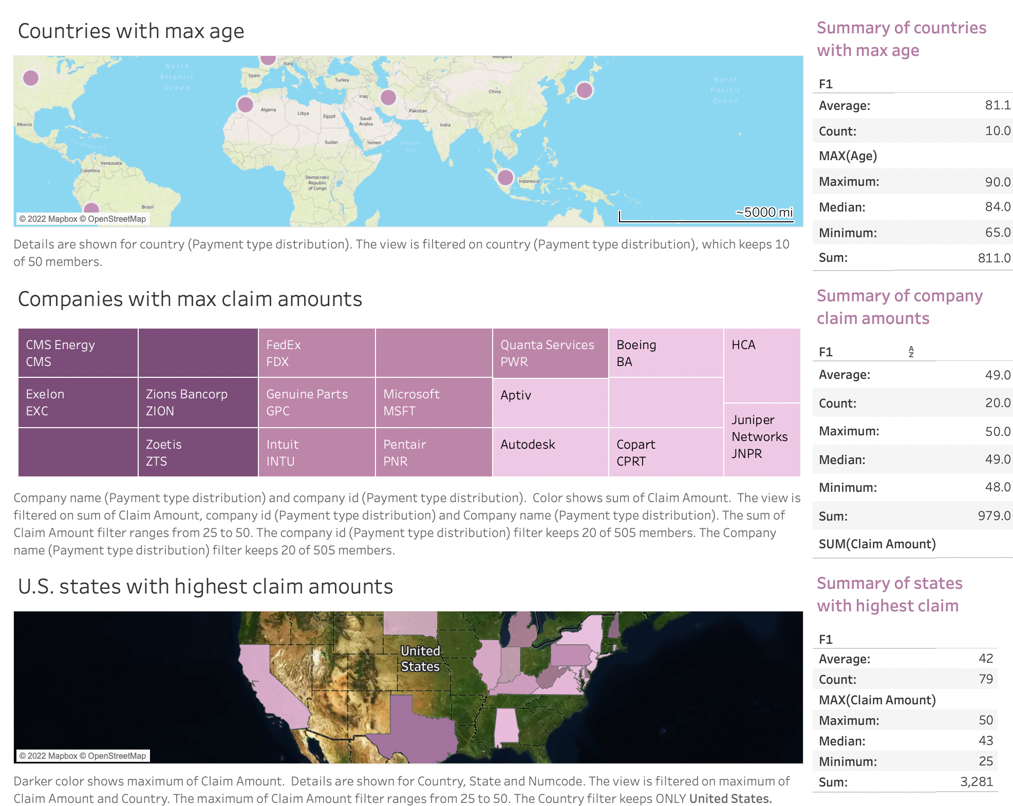
Dashboards: Countries and companies using Tableau
As a marketing executive, I would like to track countries whose senior citizens are claiming more
Also, I want to focus on U.S. states that have highest claim amounts.

Slide 33
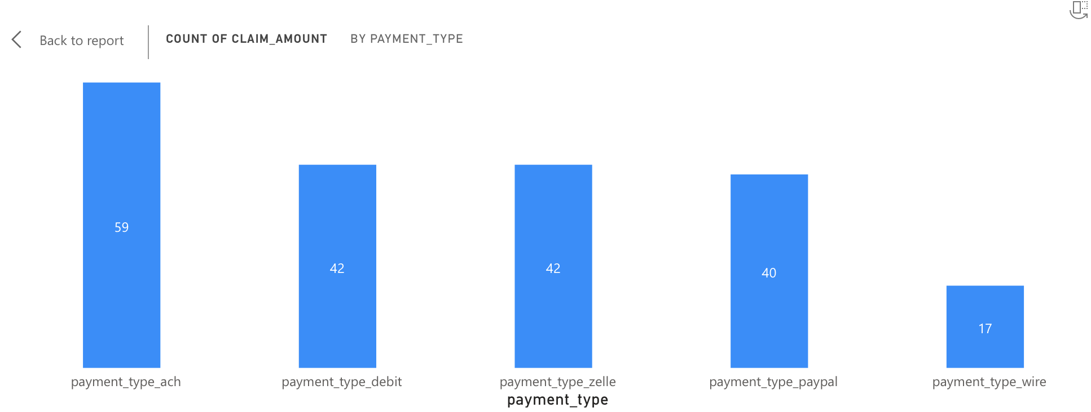
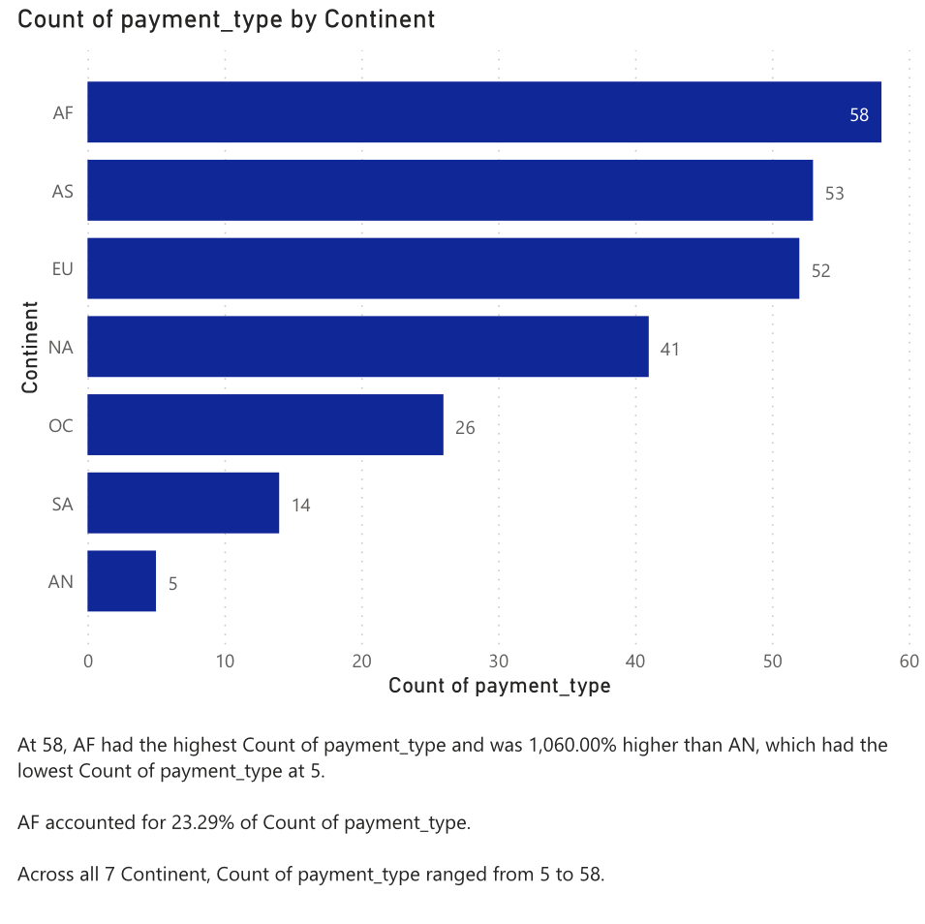
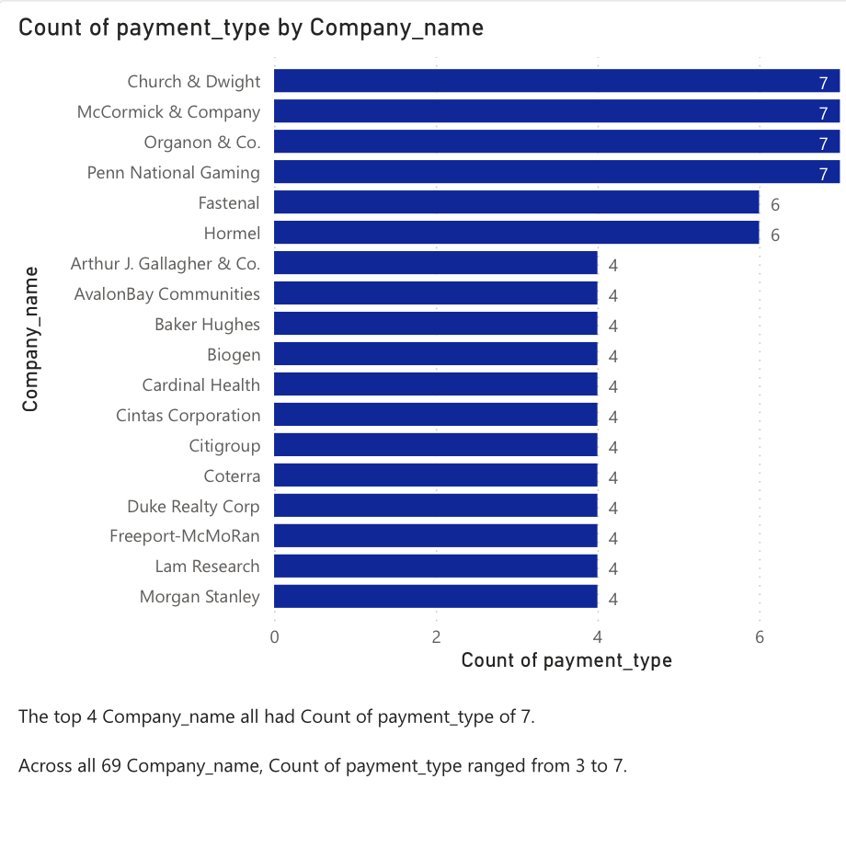
Dashboards: Payment Type Distribution

Slide 34
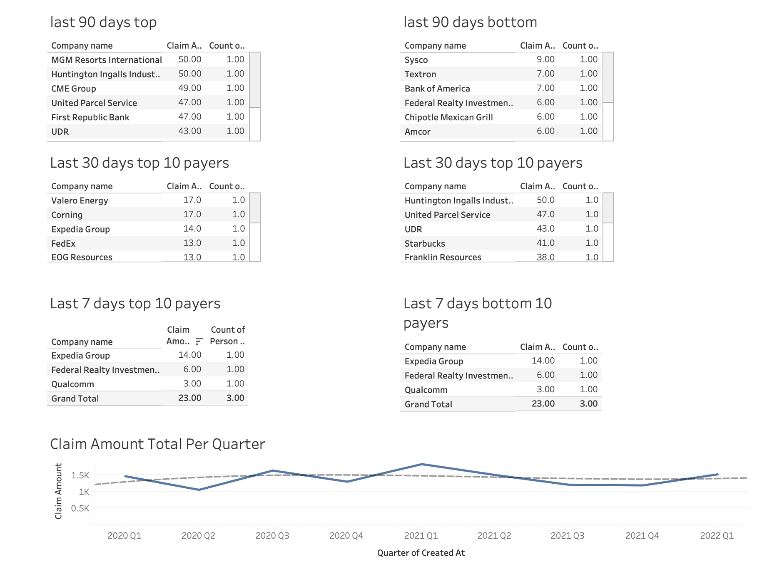
Dashboards: Payer Transactions

Slide 35
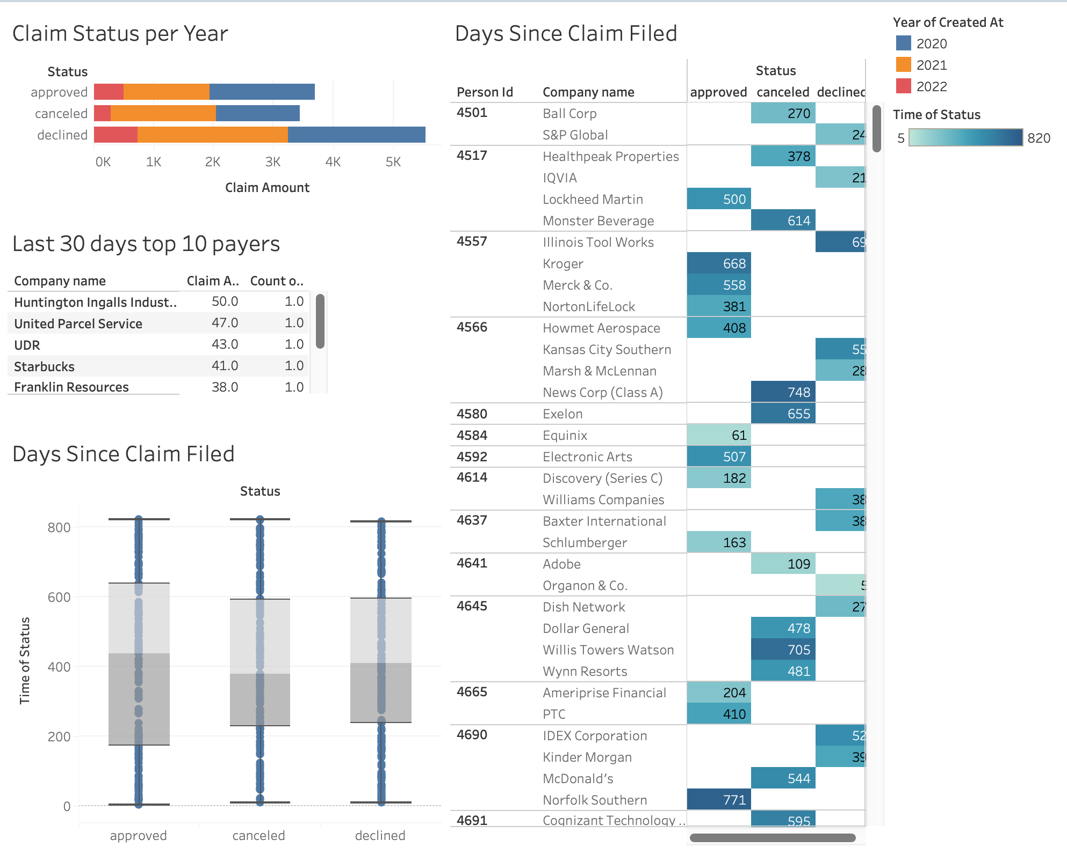
Dashboards: Payer Transactions

Slide 36
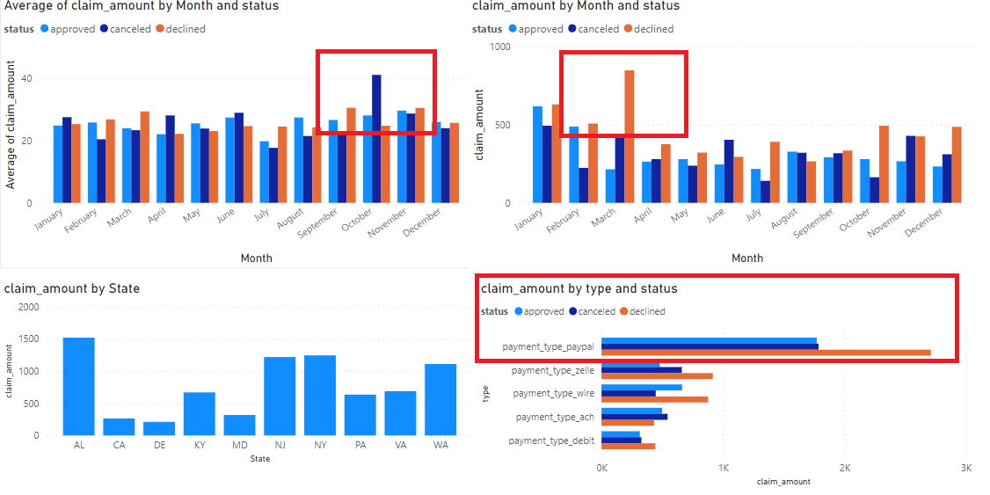
Dashboards: Claim Amount status

Slide 37
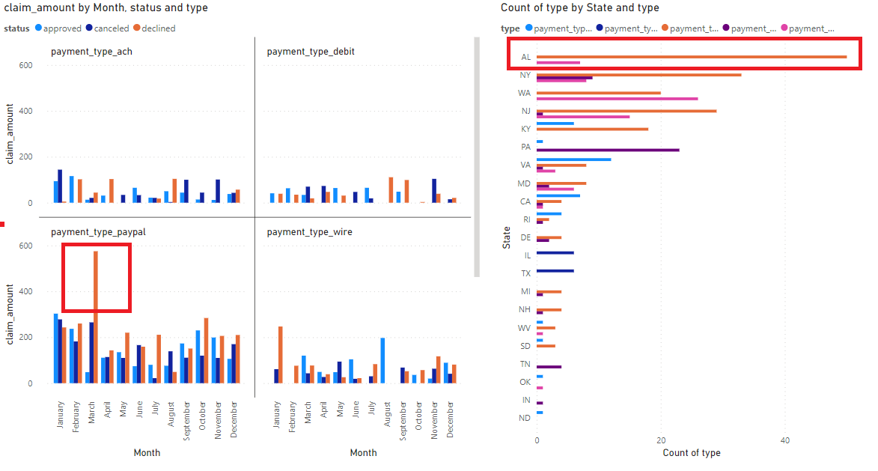
Dashboards: Status when Declined

Slide 38
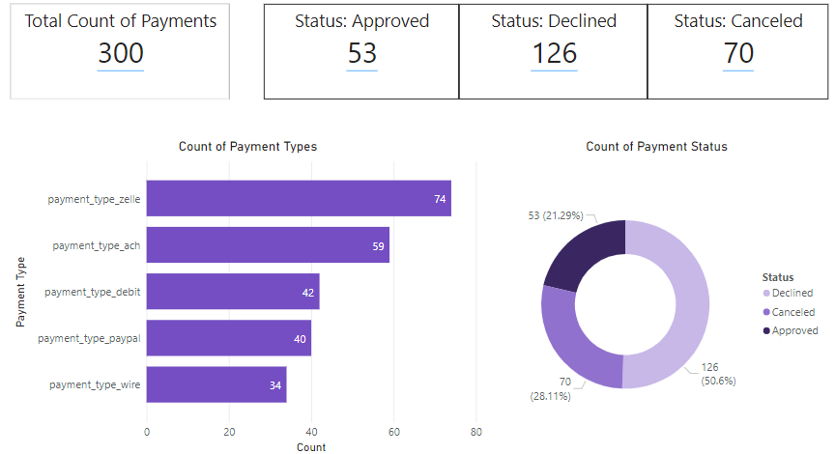
Dashboards: Payment Status Summary

Slide 39
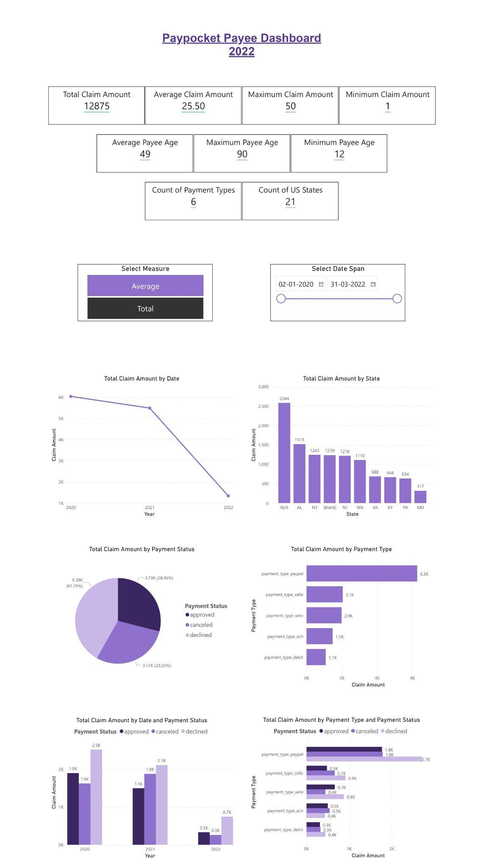
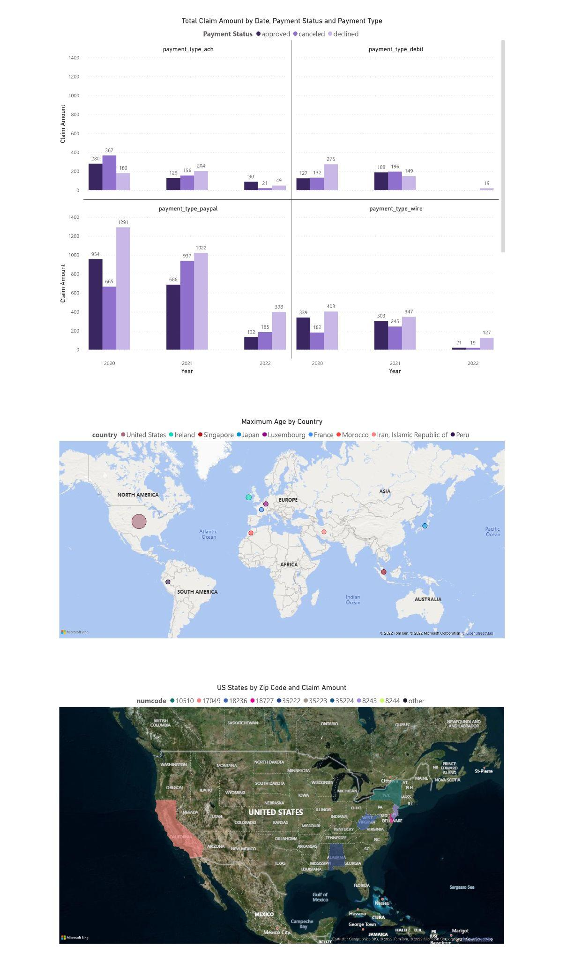
Dashboard: Payee
The link to the pdf version of the dashboard is as follows:
https://drive.google.com/file/d/1TMuQRJD1eGPwLs6n81fFUpNZ2UrhCSIc/view?usp=sharing

Slide 40
Github Repository Links
https://github.com/bmcdermott07/capstone
https://github.com/ruchiamin00/ruchiamin00
https://github.com/pkbhatta5/Paypocket_Dashboard
https://github.com/chauhayu2511/PayPocket_Dashboard
https://github.com/65suyash/PayPocket_Business-Analytics-Practicum_DNSC-6317

Slide 41
Challenges

Slide 42
Challenges: Software
01
Difficulty sharing screens
All team members had access to every document
Designated back up “screen sharer”
Logistical Issues
02
Difficult to integrate
Knowledge gap within team
Developed flat files
Focus is business analytics
Stopped Postgres Usage
03
Cost effective
Easy to access
Pre-developed purpose in software
Open Source vs Licensure
Notes:
Brooke

Slide 43
Challenges: Data Creation
01
Designate extra time to data understanding in the beginning
Develop source to target as data is being created
Insufficient Time Allocation
02
Track changes and additions in real time
Develop source to target for reproducibility
Tracking Column Selection
03
Clean the synthetic data created
Ensure it is accurate and realistic
Develop more rows than planned
Lack of Sufficient Data
Notes:
Brooke

Slide 44
Challenges: Visualizations
01
MAC OS team members obtained a 60 day free trial of PowerBI Pro to gain access to PowerBi cloud
Lack of Compatibility with Desktop PowerBI
02
Create team structure by having a designated team member to manually compile files
Sent screenshots of dashboard and their settings for reproducibility
Inability to Collaborate within PowerBI
03
Group dashboards by payer vs payee
Simple and interpretability graphs
Top N or Bottom N for tables
Overwhelming Dashboards
Notes:
Brooke

